Slide 1

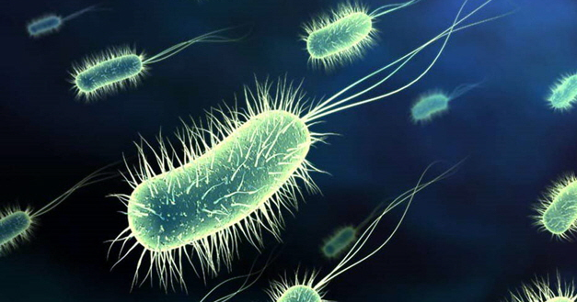
Bacteria A
By: Anyssa rodriguez, Gabrianne granado, Catherine valadez, Chris CAVILLO, SAVANNA GOMEZ, Allison Crabbe, Addie Bachle

Slide 2
ACTINOMYCES SPECIES
Intro: Actinomyces Species
Actinomyces species are facultative, anaerobic, non–spore-forming, filamentous, gram-positive rods that commonly inhabit the oropharynx. Actinomyces species are located in the oral cavity or through direct extension into fascial planes as abscesses. Actinomyces identified, the most common pathogens include A. israelii, A. viscosus, A. naeslundii, A. turicensis, and A. radingae.

Slide 3
WHERE DO THEY LIVE
Where do they live: Members of the genus Actinomyces are most often found in the mouth and gastrointestinal tract of humans and other animals. Actinomyces don’t require oxygen for growth and are sometimes referred to as anaerobic bacteria. It is actually the requirement for elevated levels of carbon dioxide. When displaced from their normal sites within the mouth or gastrointestinal tract, Actinomyces may caused diseases in humans, such as lung abscesses, appendicitis, and lumpy jaw, which is also seen in cattle
These are a gram-positive bacterium found commonly in soil.

Slide 4
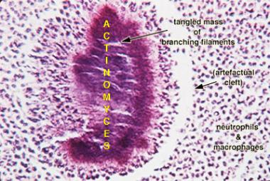
RESERVOIR
Humans are the natural reservoir for Actinomyces spp., especially A. israelii. They are part of the normal oral flora and form a significant component of dental plaque on tooth surfaces. Actinomyces spp. are mostly found in intestinal surfaces and mucosal surfaces of humans and animals, blood, female and male genital and urinary tracts.

Slide 5
RISKS
Actinomyces strong risk factors include injury or inflammation of the oral cavity, diabetes mellitus, immunosuppression, local tissue damage by trauma or irradiation and aspiration.
You have an increased risk of developing actinomycosis if you:
have a damaged immune system from medications or another illness
are malnourished
neglect dental care after dental surgery or trauma to the mouth or jaw
One of the most common causes of actinomycosis is an oral or a dental abscess.
When working in areas such as dentistry, one can often have this transmitted to humans orally and directly from cuts inside of the mouth. The risk in humans include I – actinomycosis, nodular- supportive lymphadenitis.
Actinomycosis can lead to chronic, purulent, or pus-filled, inflammation of deep tissue. It can result in tissue death and the formation of cavities and fibrotic mass, or "knots" of fibrous tissue.
The infectious dose of this bacteria is unknown.

Slide 6
HOST RANGE AND MODE OF TRANSMISSION
Host Range: Humans and animals, including pigs, dogs, cats, horses, cattle and marine mammals.
MODE OF TRANSMISSION: The Actinomyces spp. commonly inhabits the oral cavity, the gastrointestinal tract, and the female genital tract, where they exist as commensals. Infection occurs when mechanical insult disrupts the mucosal barrier or organisms gain access to privileged sites. Actinomyces spp. is also presumed to be transmitted via direct contact between individuals as part of the normal oral flor

Slide 7
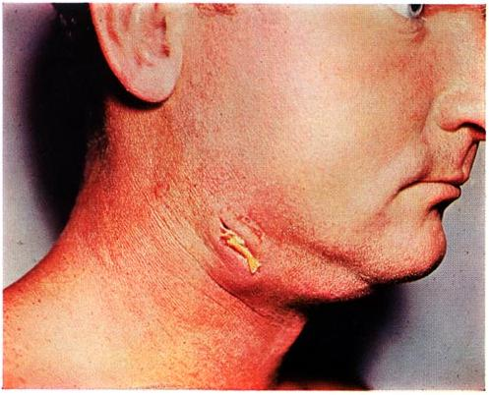
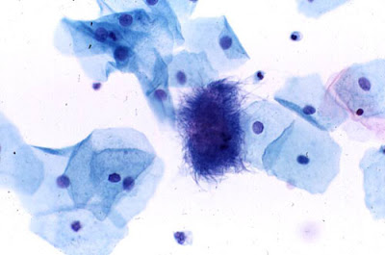
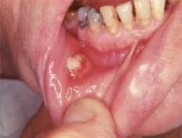
ACTINOMYCES

Slide 8
CITATIONS
Disalvo, Art. “Actinomycetes .” ACTINOMYCETES, www.microbiologybook.org/mycology/mycology-2.htm.
“Actinomycosis.” Medical Encyclopedia, medical-enc.com/actinomycosis.html.
“Actinomycosis.” Actinomycosis - STEP2/3 Infectious Disease - Step 2 & 3 - Medbullets.com, www.medbullets.com/step2-3-infectious-disease/21815/actinomycosis.
Canada, Public Health Agency of. “Pathogen Safety Data Sheets: Infectious Substances – Actinomyces Spp.” Canada.ca, 4 Sept. 2014, www.canada.ca/en/public-health/services/laboratory-biosafety-biosecurity/pathogen-safety-data-sheets-risk-assessment/actinomyces-pathogen-safety-data-sheet.html.
Wint, Carmella, and Matthew Solan. “Actinomycosis.” Healthline, Healthline Media, 11 Jan. 2016, www.healthline.com/health/actinomycosis#risk-factors4.
“Actinomycetes.” The Free Dictionary, Farlex, encyclopedia2.thefreedictionary.com/Actinomycetes.

Slide 9
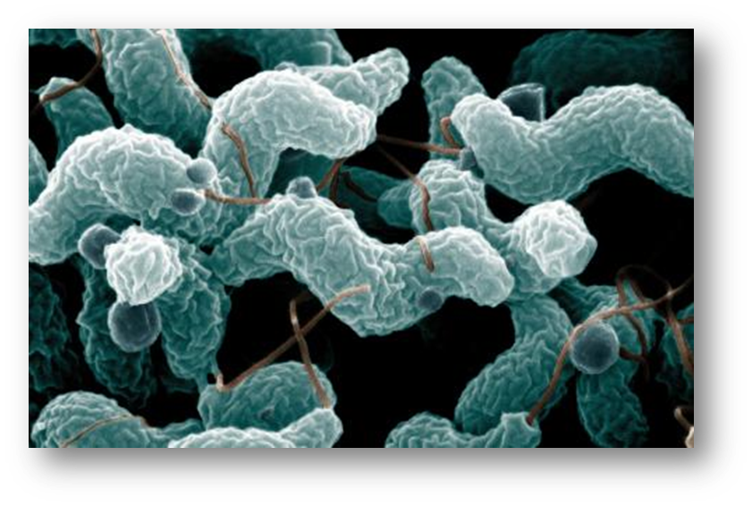
Campylobacter Coli:
Campylobacter coli is a microaerobic, non-spore forming, gram-negative, oxidase-positive bacterium of the Camplobacteraceae family. They form motile, spiral shaped rods and moves by a corkscrew-like motion. One unsheathed polar flagella are present at the end (or both ends) of the cell, which gives the bacterium a slender “S” shape, and this spiral appearance is its most distinguishable feature. C. coli grows slowly in culture and have an optimum temperature of 42°C..

Slide 10
HOST RANGE ANDINFECTIOUS DOSE:
HOST RANGE: Pigs are the main host, humans, avian animals, and a wide range of other animals such as cattle, and sheep can also be infected.
Infectious Dose: As low as 500 organisms by ingestion. One volunteer study found that 9000 bacteria were required to infect 50 percent of subjects.

Slide 11
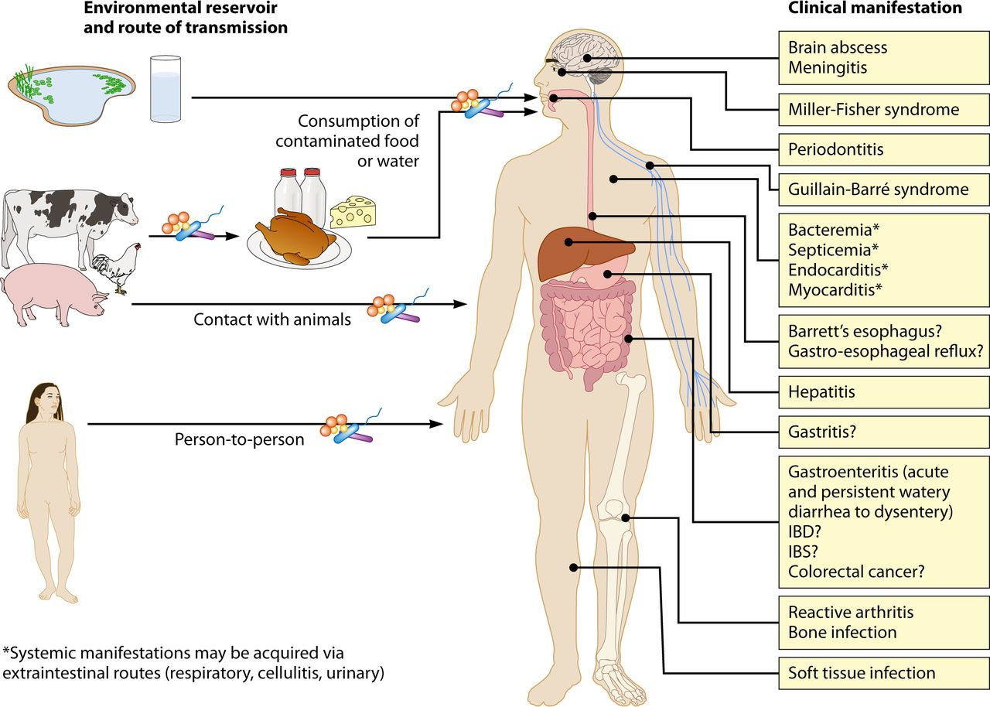
RESERVOIR AND MODE OF TRANSMISSION
RESERVOIR: Pigs, poultry, cattle, sheep, birds, Nearly all natural water sources are contaminated with C. coli
MODE OF TRANSMISSION: Oral ingestion of bacteria from contaminated food (primarily chicken) or contaminated drinking water. Contact with animals and their feces is also a source of infection. The prevalence of campylobacter on chicken carcasses is very high and cross contamination can easily occur during food preparation.

Slide 12
Campylobacter Jejuni:
HOST RANGE: C. jejuni subsp. jejuni: humans, cattle, wild birds, poultry, pigs, sheep, dogs, cats, water, mink, rabbits, and insects. C. jejuni subsp doylei can be found in humans.
INFECTIOUS DOSE: 500 organisms by ingestion. One volunteer study found that 9000 bacteria were required to infect 50 percent of subjects.
MODE OF TRANSMISSION: Oral ingestion of bacteria from faecally contaminated food (primarily chicken) or drinking water is the main mode of transmission Footnote 4, Footnote 11. Contact with animals and their feces is also a source of infection.

Slide 13
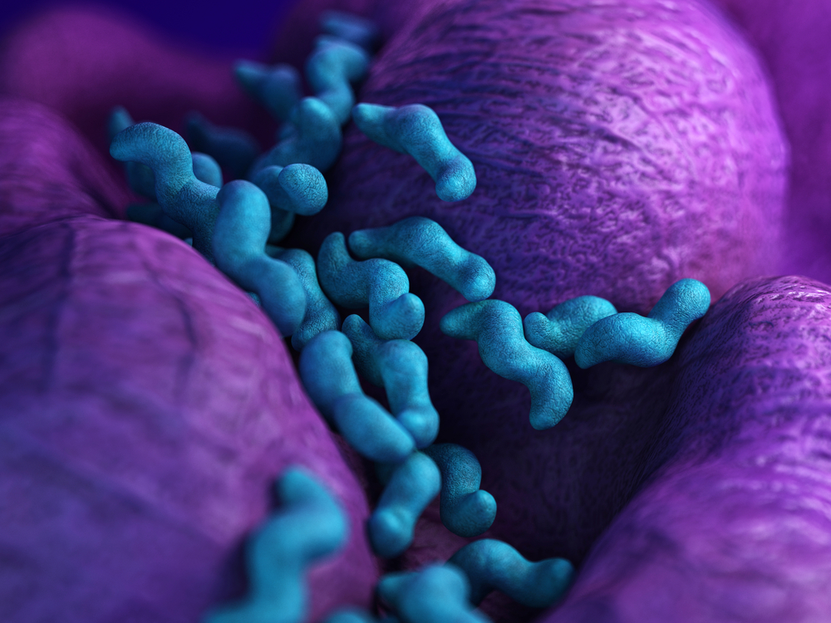
RESERVOIR
RESERVOIR: C. jejuni subsp. jejuni: humans, cattle, wild birds, poultry, pigs, sheep, dogs, cats, water, mink, rabbits, and insects. C. jejuni subsp doylei can be found in humans.

Slide 14
CAMPYLOBACTER JEJUNI
Campylobacter jejuni is the most common cause of bacterial foodborne illness in the United States.
Campylobacter is found most often in food, particularly in chicken. Food is contaminated when it comes into contact with animal feces. Any raw poultry may contain Campylobacter, including organic and “free range” products.
CAMPYLOBACTER SYMPTOMS
Symptoms of food poisoning from Campylobacter usually occur 2 to 5 days after a person eats contaminated food, but may take up to 10 days to appear. The most common symptom of a Campylobacter infection is diarrhea, which is often bloody. Typical symptoms include:
Diarrhea: Diarrhea ranges from mild to severe and is often bloody
Fever
Nausea
Vomiting
Abdominal pain
Headache
Muscle pain

Slide 15
COMPLICATIONS
COMPLICATIONS OF CAMPYLOBACTER INFECTION
Guillan-Barré Syndrome (GBS): Although rare it is the most common cause of acute generalized paralysis in the western world. GBS occurs when the antibodies the body builds up against Campylobacter attack one’s nerve cells. Symptoms of GBS appear several weeks after diarrheal illness. Approximately one in every 1000 reported Campylobacter cases results in GBS.

Slide 16
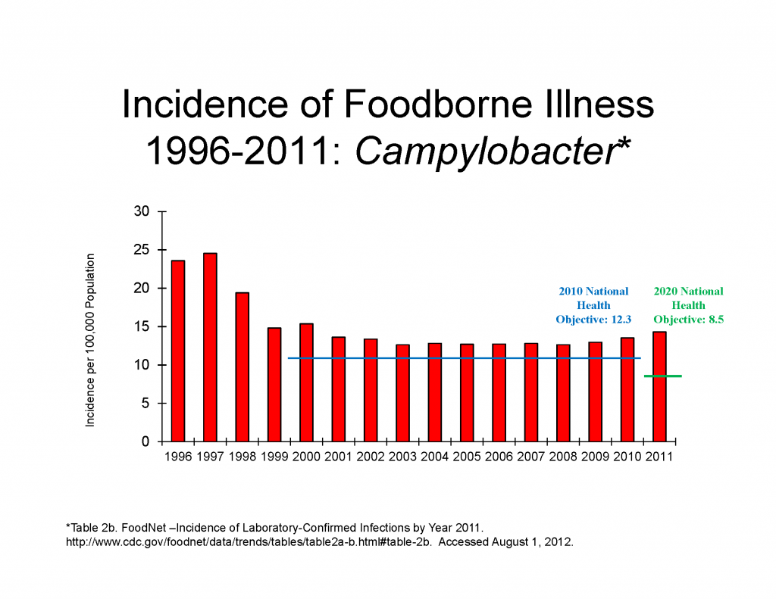
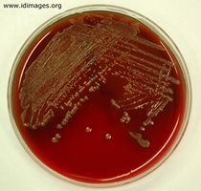
CAMPYLOBACTER PICTURES

Slide 17
CITATIONS
Citations
Government of Canada, Public Health Agency of Canada. “Common Menu Bar Links.” ARCHIVED - Campylobacter - C-EnterNet 2009 Annual Report - Public Health Agency Canada, 23 Feb. 2012, www.phac-aspc.gc.ca/foodnetcanada/pubs/2009/ch03-eng.php.
https://www.canada.ca/en/public-health/services/laboratory-biosafety-biosecurity/pathogen-safety-data-sheets-risk-assessment/campylobacter-coli.html

Slide 18
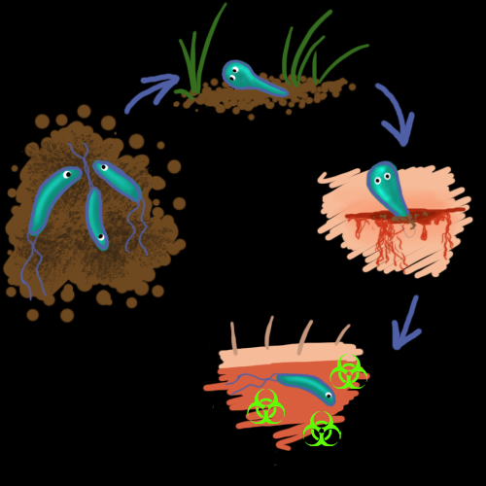
Clostridium Tetani
WHERE DO THEY LIVE:
Spores of C. tetani are everywhere. They can be found in soil, dust, animal intestines, and animal feces (including humans).
Is most commonly found in dense populated regions in hot, damp climates with soil rich in organic matter.

Slide 19
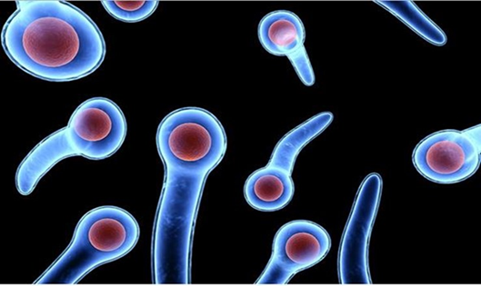
RESERVOIR
Soil, feces, sewage, marine sediments, part of human’s indigenous microbiota (lower intestinal tract of humans). C. tetani spores can remain viable in soil for many years.

Slide 20
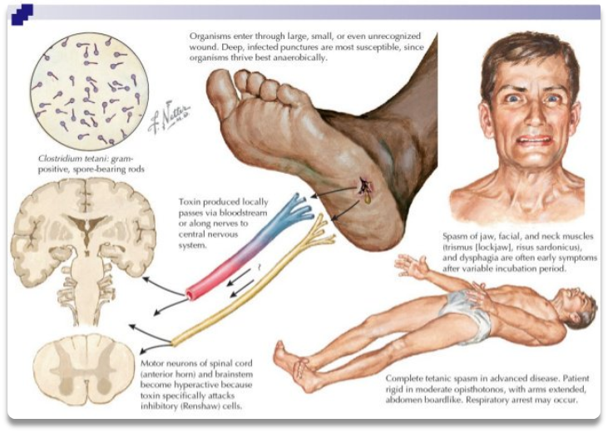
Host Range
Humans, domestic and wild animals.
C. tetani is an anaerobic gram-positive bacillus that forms spores. The bacteria have been described to look like a drumstick, racket or club. This organism is sensitive to heat and cannot survive in the presence of oxygen. However, the spores are very resistant to heat and usual antiseptics.

Slide 21
PREDISPOSING & OCCUPATIONAL RISKS
Clostridium tetani is the bacteria responsible for the often fatal disease tetanus. There are four clinical types. Incubation period ranges from 3-21 days, with an average of about a week. it has a fatality rate of 30%.
Generalized- (80%) Most common type. Toxins get distributed via lymphatic and vascular system ad spread more widely and affect more nerves. The first symptom is the lock jaw. It spreads and begins to affect the rest of your muscle, starting from your neck and moving to your back. This generalized muscle rigidity comes with reflex spasms as your body tries to respond to various stimuli. These spasms can cause fractures, tendon rupture and respiratory failure. Death from tetanus results from respiratory and cardiovascular instability. Other symptoms caused by autonomic dysfunction may include fever, sweating and high blood pressure. Recovery can take months but is usually complete unless complications occur.
Localized- is very uncommon. Patients whom experience this clinical type experience muscle rigidity close to the site of injury. These contractions can occur for many weeks before disappearing. The fatality rate of this clinical type is 1%.
Cephalic- for of localized disease that affects the cranial nerves. May occur after ear infections or head injuries. This clinical type can affect the muscles in your face, such as the eyelid, tongue, lips, etc.
Neonatal- form of generalized tetanus that occurs in newborn infants. Usually happens when the umbilical cord is cut with an unsterile instrument. The fatality rate for this clinical type is 90%. Very common in developing countries.

Slide 22
MODE OF TRANSMISSION
Tetanus is not transmitted from person to person. A person usually becomes infected with tetanus when dirt enters a wound or cut. Tetanus germs are likely to grow in deep puncture wounds caused by dirty nails, knives, tools, wood splinters, and animal bites.

Slide 23
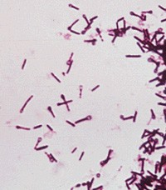
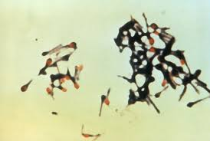
CLOSTRIDIUM TETANI PICTURES

Slide 24
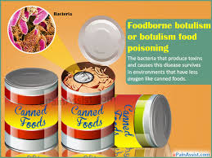
CLOSTRIDIUM BOTULINUM
WHERE DO THEY LIVE:
C. botulinum spores are often found in the soil, on the surfaces of fruits, vegetables, and meats, and in seafood.

Slide 25
REGION WHERE CAN THEY BE FOUND
C botulinum can be found in soil and marine sediments worldwide, most commonly as spores. These spores are found everywhere. While the spores are generally harmless, the danger can occur once the spores begin to grow out into active bacteria and produce neurotoxins. A neurotoxin is a poisonous chemical that affects the central nervous system. It can destroy, paralyze, or adversely affect nerves or nerve tissue. C. botulinum produces seven different types of neurotoxins designated by the letters A through G; only types A, B, E, and F cause illness in humans.

Slide 26
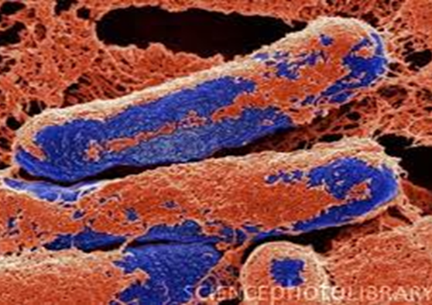
RESERVOIR AND HOST RANGE
RESERVOIR: Spores are found in soil, aquatic sediments, the intestinal tract of birds, animals and fish, and agricultural products, including honey and vegetables.
HOST RANGE: Humans and various animals, e.g., fowl, fish, cows, dogs, and minks.
Clostridium Botulinum are rod-shaped bacteria (also called C. botulinum). They are anaerobic, meaning they live and grow in low oxygen conditions. The bacteria form protective spores when conditions for survival are poor.

Slide 27
PREDISPOSING & OCCUPATIONAL RISKS AND MODE OF TRANSMISSION
PREDISPOSING & OCCUPATIONAL RISKS: Botulism is a paralyzing disease affecting the body's nervous system that is caused by the ingestion of one of the potent neurotoxins produced by C. botulinum bacterium. This neurotoxin is among the most toxic substances known; even microscopic amounts can cause illness.
MODE OF TRANSMISSION: Under conditions with little oxygen (anaerobic), botulinum spores can germinate, resulting in the growth of bacteria and the production of the toxin. Botulism is not transmitted from person to person. Botulism develops if a person ingests the toxin (or rarely, if the toxin is inhaled or injected) or if the organism grows in the intestines or wounds and toxin is released.

Slide 28
CONTINUATION
Food borne botulism: Ingestion of contaminated food containing toxin. infection is commonly associated with commercially processed foods that had undergone poor processing, storage, and improper preservation.
Wound botulism: Contamination of wounds with spores of neurotoxin producing Clostridium species and is seen almost exclusively in injection drug users, particularly those who partake in injection of black-tar heroin into skin tissue.
Intestinal (infant) botulism: Ingestion of spores. Sources include honey and infant milk powder.
Adult infectious botulism: Ingestion of clostridial spores, rather than toxin, which then colonize the gut to produce their neurotoxin directly in the gut.
Latrogenic botulism: Side effect of injection of purified toxin.
Inhalational botulism: Occurs due to absorption of botulinum toxin by the mucous membrane of the nose.

Slide 29
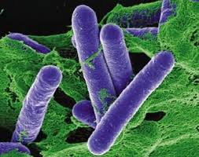
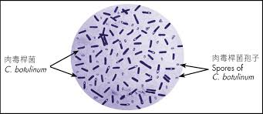
CLOSTRIDIUM BOTULINUM

Slide 30
CITATIONS
Clostridium Tetuani
1. “Tetanus - the Disease.” WHO | Tetanus, World Health Organization, www.who.int/immunization/topics/tetanus/en/index1.html.
2.http://web.uconn.edu/mcbstaff/graf/Student%20presentations/C%20tetani/Ctetani.html
Clostridium botulinum
1. https://www.fsis.usda.gov/wps/portal/fsis/topics/food-safety-education/get-answers/food-safety-fact-sheets/foodborne-illness-and-disease/clostridium-botulinum/ct_index
2. http://www.health.gov.on.ca/en/public/publications/disease/botulism.aspx

Slide 31
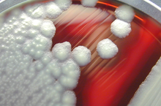
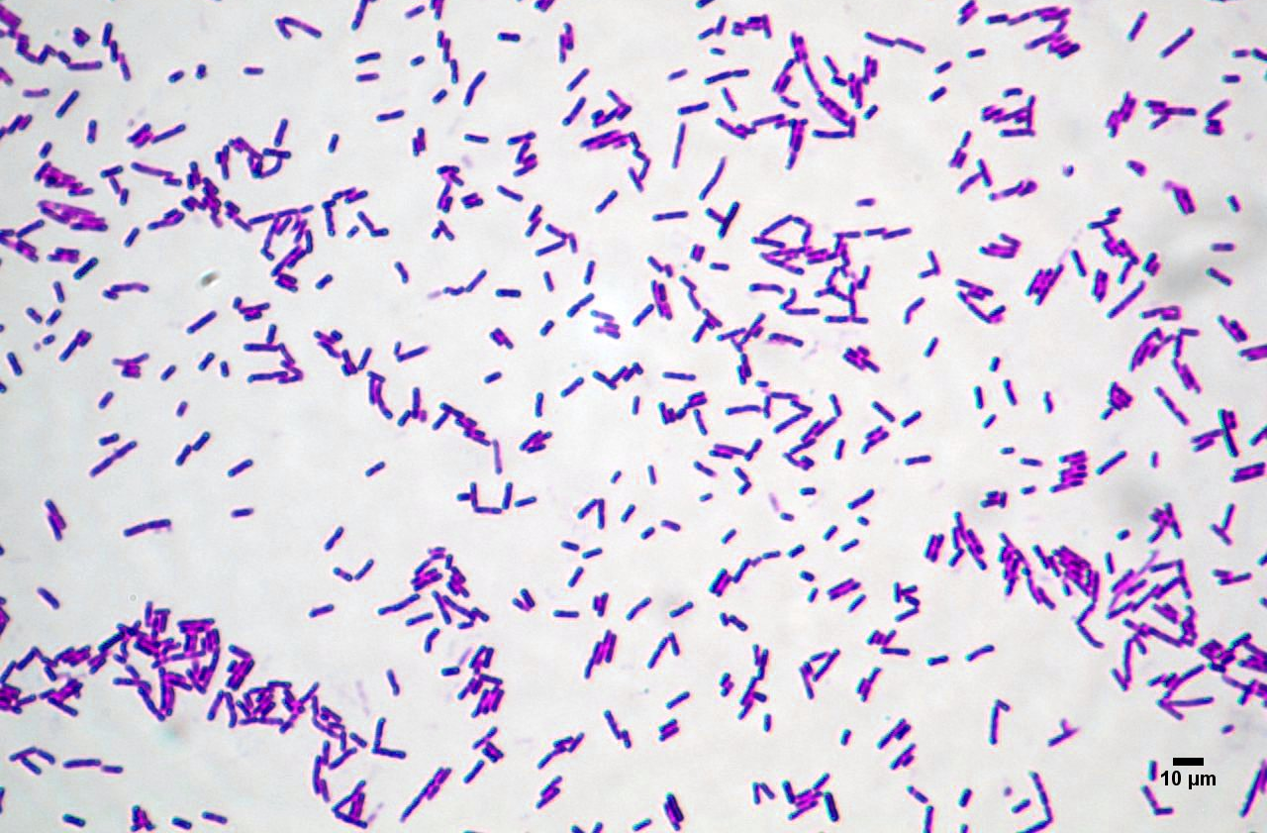
Bacillus Cereus
Gerneral Characteristics:
  Gram Positive rod shaped
  Usually in pairs and short chains
  Facultative anaerobes
  Colonial Morphology – white granular texture
  Temperature: above 10-20°C and below 35-45°C
  Optimum temperature is about 37°C

Slide 32
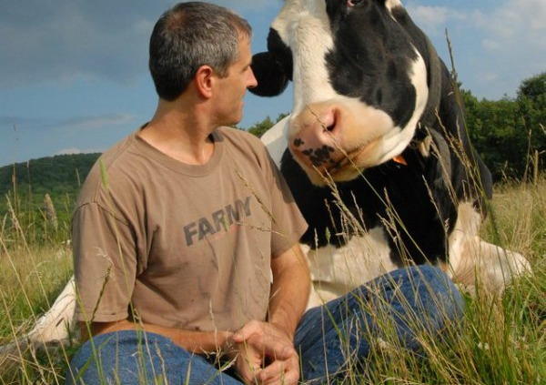
Bacillus Cereus
Where they live?
  In Nature
    Animals
    Food
    Soil
Regions
  All regions
  Mostly where improper food handling occurs
  Outbreaks in Netherlands, Parts of Europe, Canada, Japan and US in 1973-1985
  Norway high incidences in 1990
  103 outbreaks in US 2008

Slide 33
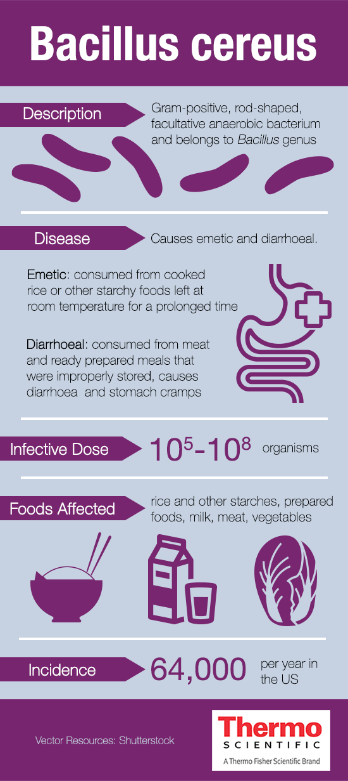
Bacillus Cereus
Host Range
  Animals and Humans
  Immunocompromised individuals
  Intravenous drug users
  Neonates

Slide 34
Bacillus Cereus
Predisposing and Occupational Risk
  Food poisoning syndromes
    Emetic Type- Nausea, vomiting, malaise, occasional diarrhea
    Diarrheal Type-Profuse watery diarrhea, rectal tenesmus, abdominal cramps, occasional fever and vomiting
  Wound Infections
  Opportunistic Infections
  Peripheral Infections
  Some strains harbor plasmid bearing B. Anthracis-like virulence-Pnuemonia in immune compromised
  Hospitals- pose occupational risk however it is rare because high amounts are needed to infect

Slide 35
Bacillus Cereus
Infectious Dose
  Diarrheal type- the enterotoxin is produced by organisms in the small intestine
    Dose there is 10⁴-10⁹ cells per gram of food.
  Emetic Type- Ingested in food
    Dose about 10⁵-10⁸ cells per gram in order to produce sufficient toxin

Slide 36
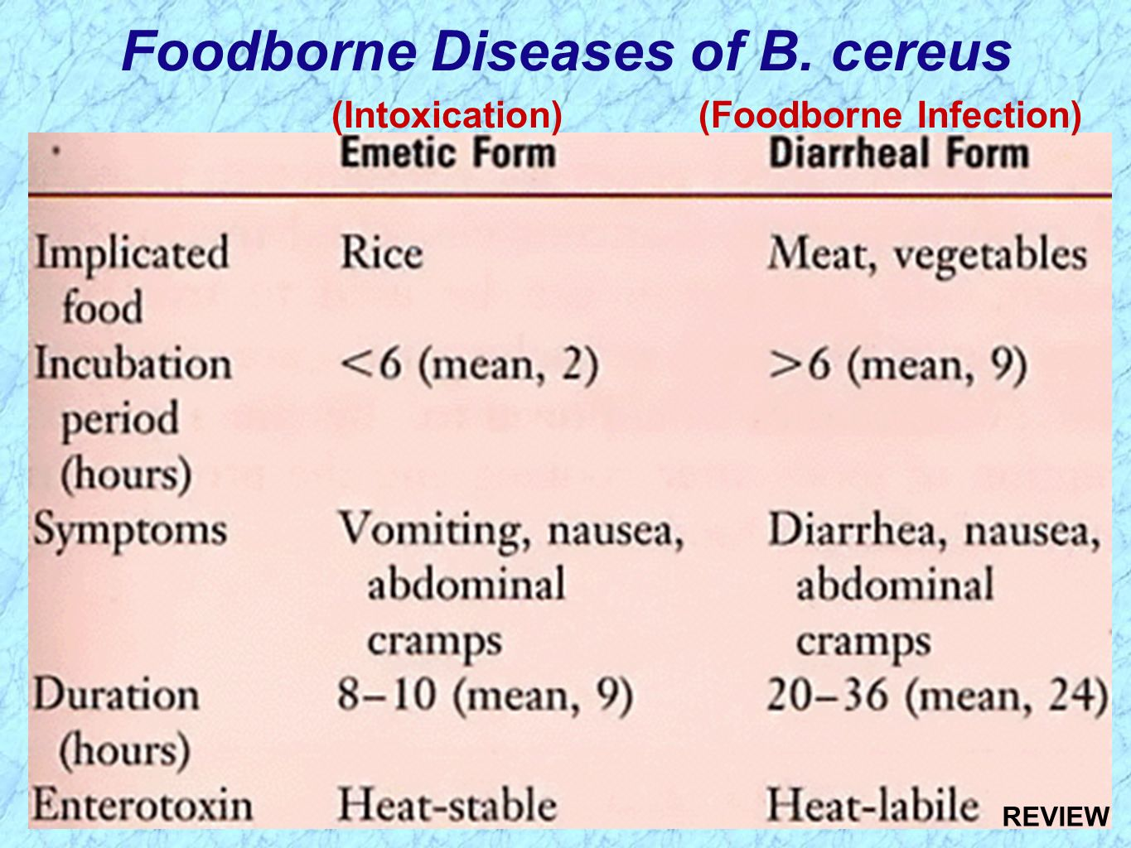
Bacillus Cereus
Mode of Transmission
  Contaminated food
    Emetic Type- associated with rice and pasta
    Diarrheal Type – Milk products and Infant Milk Formula (IMF)
  Hospitals
    Transmitted via linen

Slide 37
Bacillus Cereus
Resources:
Desriac, Noemie, et al. “Bacillus Cereus Cell Response upon Exposure to Acid Environment: toward the Identification of Potential Biomarkers.” Frontiers in Microbiology, vol. 4, 2013, doi:10.3389/fmicb.2013.00284
Ceuppens, Siele, et al. “Impact of Intestinal Microbiota and Gastrointestinal Conditions on the in Vitro Survival and Growth of Bacillus Cereus.” International Journal of Food Microbiology, vol. 155, no. 3, 2012, pp. 241–246., doi:10.1016/j.ijfoodmicro.2012.02.013.
Haughton, Phillipa, et al. “Emergence Of Bacillus Cereus As A Dominant Organism In Irish Retailed Powdered Infant Formulae (Pif) When Reconstituted And Stored Under Abuse Conditions.” Journal of Food Safety, vol. 30, no. 4, 2010, pp. 814–831., doi:10.1111/j.1745-4565.2010.00244.x.
O’Connell, A., et al. “Detection of Presumptive Bacillus Cereus in the Irish Dairy Farm Environment.” Irish Journal of Agricultural and Food Research, vol. 55, no. 2, Jan. 2016, doi:10.1515/ijafr-2016-0014.
Wu, Minxi, et al. “Decontamination of Multiple Heavy Metals-Containing Effluents through Microbial Biotechnology.” Journal of Hazardous Materials, vol. 337, 2017, pp. 189–197., doi:10.1016/j.jhazmat.2017.05.006.

Slide 38
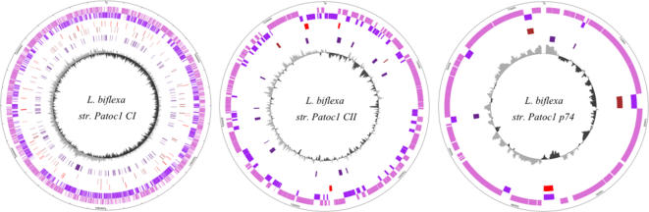
Leptospira Biflexa
General Information
General Information
  Gram Negative spiral
  1st saprophytic Leptospira to have whole genome sequenced
    3,590 protein coding genes
    3 Circular Replicons
    1/3 of the genes are absent in the pathogenic form
    Non-pathogenic
    Does not undergo rearrangements and recombination's like the pathogenic form

Slide 39
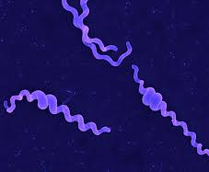
Leptospira Biflexa
Where does it naturally live?
  Free Living
  Aquatic environment
Since they are non-pathogenic
  No host range, risk of disease, or infectious dose

Slide 40
Leptospira Biflexa
Resources:
Desriac, Noemie, et al. “Bacillus Cereus Cell Response upon Exposure to Acid Environment:Wu, Minxi, et al. “Decontamination of Multiple Heavy Metals-Containing Effluents through Microbial Biotechnology.” Journal of Hazardous Materials, vol. 337, 2017, pp. 189–197., doi:10.1016/j.jhazmat.2017.05.006.
Picardeau, Mathieu, et al. “Genome Sequence of the Saprophyte Leptospira Biflexa Provides Insights into the Evolution of Leptospira and the Pathogenesis of Leptospirosis.” PLoS ONE, vol. 3, no. 2, 2008, doi:10.1371/journal.pone.0001607.
Canada, Public Health Agency of. “Pathogen Safety Data Sheets: Infectious Substances – Actinomyces Spp.” Canada.ca, 4 Sept. 2014, www.canada.ca/en/public-health/services/laboratory-biosafety-biosecurity/pathogen-safety-data-sheets-risk-assessment/actinomyces-pathogen-safety-data-sheet.html.

Slide 41
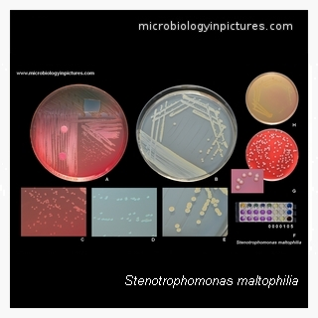
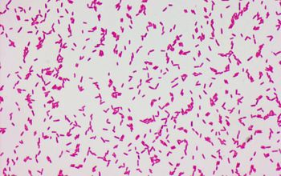
Stenotrophomonas maltophilia
General Characteristics:
-Stenotrophomonas maltophilia is a motile, rod shaped, gram-negative non-fermentative bacillus previously known as Pseudomonas maltophilia and Xanthomonas maltophilia. The bacterium is an obligate aerobe that is common throughout the environment, particularly in water.

Slide 42
Stenotrophomonas maltophilia
Natural Environment
-S. maltophilia is an environmental bacterium found in aqueous habitats, including plant rhizospheres, animals, foods, and water sources.
- S. maltophilia is an environmental multiple-drug-resistant organisms (MDRO). It has been isolated from aqueous-associated sources both inside and outside the hospital/clinical setting.

Slide 43
Stenotrophomonas maltophilia
Region:
S. maltophilia is emerging as a significant pathogen worldwide as it spreads within communities and health care settings
Hospitals in several different countries perform surveillance on infections due to S. maltophilia. A U.S. multiple-hospital study of patient infections in the ICU during 1993 to 2004 reported S. maltophilia as being among the 11 most frequently recovered organisms (4.3% of a total of 74,394 Gram-negative bacillus isolates).

Slide 44
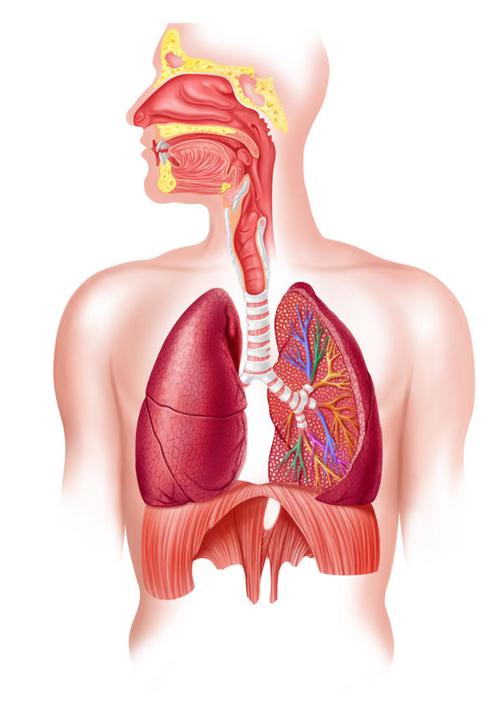
Stenotrophomonas maltophilia
Reservoir:
- Infections of S. maltophilia can occur in a range of organs and tissues; the organism is commonly found in human respiratory tract infections.

Slide 45
Stenotrophomonas maltophilia
Host Range:
Exhibits an unusually broad host ranges capable of infecting bacteria across taxonomic orders.
Worldwide spread of humans allows for the spread of this bacteria, especially in areas with large clinical settings.

Slide 46
Stenotrophomonas maltophilia
Risks & Infectious Dose
-Risk factors for S. maltophilia infection include underlying malignancy, the presence of indwelling devices (e.g., catheters), chronic respiratory disease, immunocompromised host, prior use of antibiotics, and long-term hospitalization or ICU stay
-Risk factors for S. maltophilia infection-associated mortality include malignancy, severe septic shock, and organ failure
-Some of the infections associated with S. maltophilia include pneumonia, bacteremia, meningitis, endocarditis, catheter-related bacteremia/septicemia and acute exacerbations in patients with cystic fibrosis and chronic obstructive pulmonary disease
-It is an obligate aerobe, and is capable of growth between 5o and 40oC

Slide 47
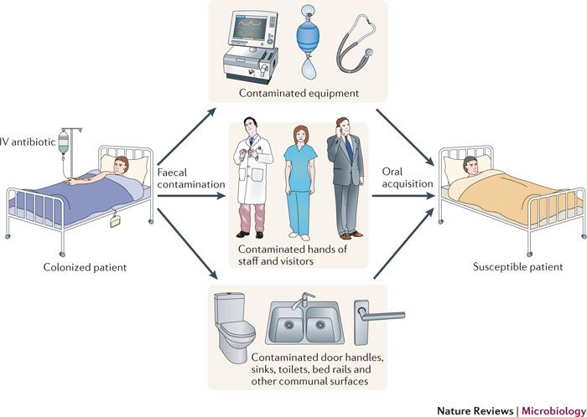
Stenotrophomonas maltophilia
Mode of transmission:
-The transmission of S. maltophilia to susceptible individuals may occur through direct contact with the source. The hands of health care personnel have been reported to transmit nosocomial S. maltophilia infection in an intensive care unit (ICU)
-Cough-generated aerosols from CF patients have the potential to provide airborne transmission of S. maltophilia

Slide 48
Citations
Stenotrophomonas maltophilia
Brooke, Joanna S. “Stenotrophomonas maltophilia: an Emerging Global Opportunistic Pathogen.” Clinical Microbiology Reviews, American Society for Microbiology, Jan. 2012, www.ncbi.nlm.nih.gov/pmc/articles/PMC3255966/.
HansN. “Staphylococcus aureus.” Microbiology pictures - photo gallery of medically important bacteria. Microbiology in pictures, bacteria images and photographs with texts. On-Line photo atlas of bacteria., www.microbiologyinpictures.com/index.php.
Peters, Danielle L., et al. “The isolation and characterization of two Stenotrophomonas maltophilia bacteriophages capable of cross-Taxonomic order infectivity.” BMC Genomics, BioMed Central, 2015, www.ncbi.nlm.nih.gov/pmc/articles/PMC4559383/.
Stenotrophomonas maltophilia, microbe-canvas.com/Bacteria/gram-negative-rods/obligate-aerobic-3/oxidase-negative-3/colistin-susceptible-5/stenotrophomonas-maltophilia.html.

Slide 49
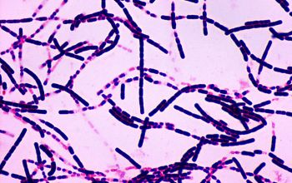
Bacillus Anthracis
Causes the disease Anthrax
Basics:
  No motility
  Aerobic
  Gram positive
  Rod-shaped
This bacteria doesn’t have motility, so it most often travels by water, animals, and wind
  Wind isn’t a cause of the disease because the dilution factor is too great to cause any disease

Slide 50
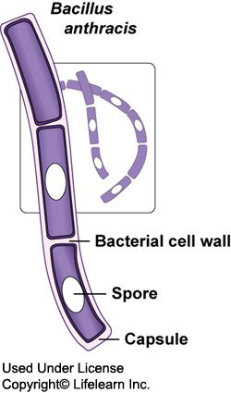
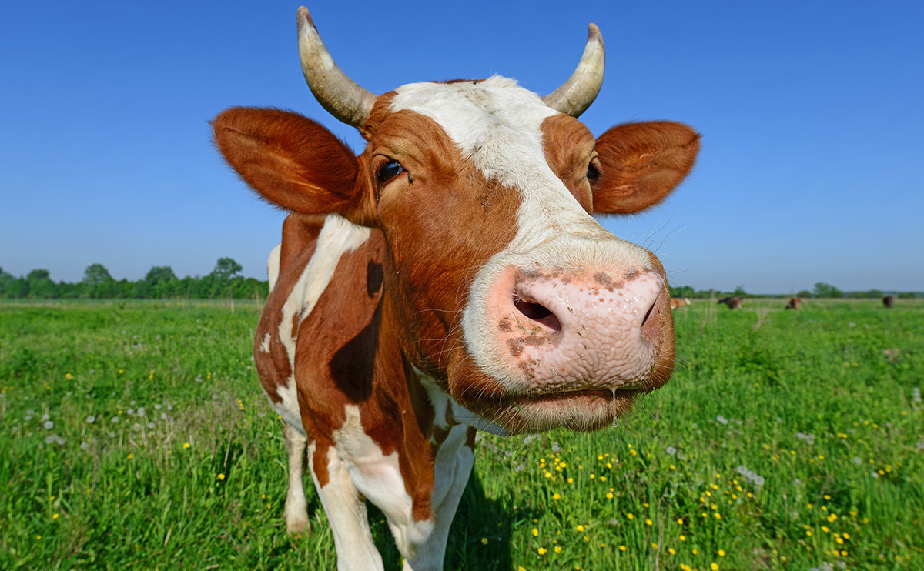
Bacillus Anthracis
  It is known as a herbivore disease
  Reservoir:
    Almost always in spore form and in this form it can live for years in soil, animal hides, and hair under most environmental conditions
  Host Range:
    Cattle; sheep, cows, goats, horses, and pigs
  Seasonality
    In humans, it is more dependent on human activity than climate
    In nature, it does better in warm climate

Slide 51
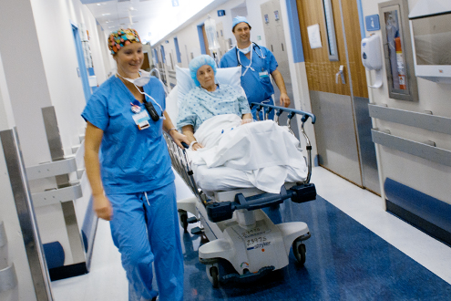

Bacillus Anthracis
Where it is found:
  Found everywhere where there is dust
    Commonly found in soil and areas where there is an accumulation of dust
  Areas of concern:
    It is a concern and controlled in hospitals, water sources, and the international space station
  Where it is found in the World;
    It is a large issue in Chile, India, and Russia, but it is found in low amounts everywhere.
    In the US, it is found in a population of White tailed deer in West Texas

Slide 52
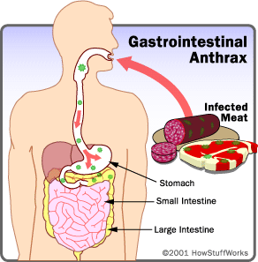
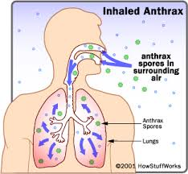
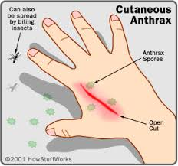
Bacillus Anthracis
Infection:
  Infectious dose: 8,000-50,000 organisms through inhalation
  It can be contracted from ingestion, inhalation, and cutaneous
  Always contracted through the spore form
  Flies are common vectors
  Symptoms:
    Fever and shock
    itchy sore
    Headache
    Incubation is within 7 days

Slide 53

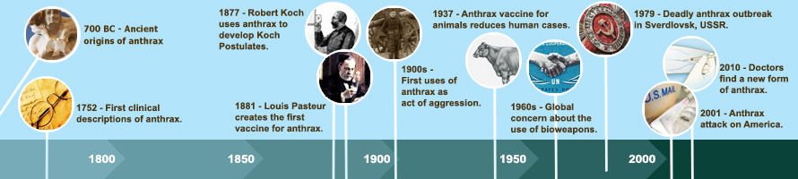
Bacillus Anthracis
Biggest Concerns;
  Has been developed as a biochemical warfare and bioterrorism weapon
    Was used in the “Anthrax letter incident” in 2001 where letters containing this were sent to senators
    It is difficult to identify and differentiate compared to other bacillus

Slide 54
Bacillus Anthracis
Resources;
“Anthrax.” Centers for Disease Control and Prevention, Centers for Disease Control and Prevention, 1 Sept. 2015, www.cdc.gov/anthrax/basics/index.html.
Canada, Public Health Agency of. “Pathogen Safety Data Sheets: Infectious Substances – Bacillus Anthracis.” Canada.ca, 18 Feb. 2011, www.canada.ca/en/public-health/services/laboratory-biosafety-biosecurity/pathogen-safety-data-sheets-risk-assessment/bacillus-anthracis-material-safety-data-sheets-msds.html.
Texas Department of Health, Zoonosis Control Division. “Basic Fact Sheet – Anthrax in Animals.” 2 July 2017, p. 1., doi:10.18411/a-2017-023.
The New York Times, The New York Times, www.nytimes.com/health/guides/disease/anthrax/overview.html.

Slide 55
Coxiella Burnetii
General information
  It is a pleomorphic, Gram-negative, spore-forming coccobacillus. It is an obligate intracellular pathogen, and completes its development cycle in the phagolysosome. It exists in two different forms: 1) a small-cell variant, consisting of an electron-dense center of condensed nucleoid filaments; and 2) a large cell variant, which is less electron-dense and is the metabolically active intracellular form
  Coxiella burnetii is the causative agent of Q fever

Slide 56
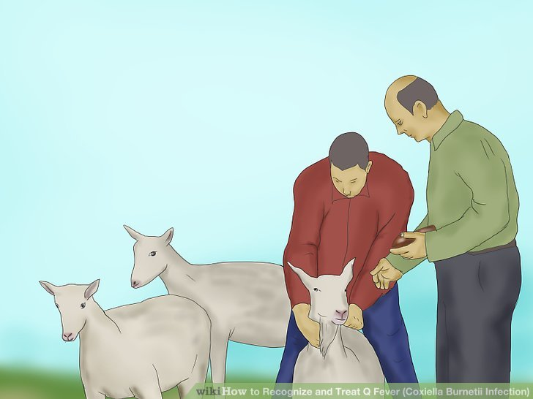
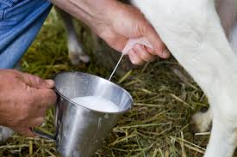
Coxiella Burnetii
Where can it be found?
    In regions where Infected arthropods, blood, urine, feces, milk, yolk sac suspensions, contaminated laundry and clothing, naturally or experimentally infected animals, and tissues of humans or other hosts
  Epidemics also occur in stockyards, meat packing facilities, and medical labs. Outbreaks are common among abattoir workers, farmers, veterinary surgeons, hide handlers, and butchers

Slide 57
Coxiella Burnetii
Reservoir
  Farm animals such as cattle, goats, and sheep; pets such as cats, rabbits, and dogs. Along with Many wild animals, including coyotes, mice, and birds.
  Host Range is humans and many different wild and domesticated animas
Surroundings
  C. burnetii can withstand harsh environmental conditions. It can survive at 15-20°C for 10 months, on meat in cold storage for more than 1 month, in skim milk at room temperature for more than 40 months. As well as in soil, contaminated buildings, food and fomites for years.
Infectious dose
  Approximately 1-10 organisms are required to cause infection.

Slide 58
Coxiella Burnetii
Symptoms : a high fever, chills or sweats, a cough, chest pain while breathing, a headache, clay-colored stools, Diarrhea, nausea.
Sources it comes from
  Infected arthropods, blood, urine, feces, milk, yolk sac suspensions, contaminated laundry and clothing, naturally or experimentally infected animals, and tissues of humans or other hosts
Mode of transmission
  Transmission occurs mainly via inhalation of contaminated aerosols from amniotic fluid, placenta, or contaminated wool from farm animals
  Direct or indirect contact with infected animals, Raw milk ,Ticks

Slide 59
Resources
Pathogen Regulation Directorate, ‘Public Health Agency of Canada-Coxiella burnetii, November 2010’ www.canada.ca/en/public-health/services/laboratory-biosafety-biosecurity/pathogen-safety-data-sheets-risk-assessment/bacillus-anthracis-material-safety-data-sheets-msds.html.
https://en.wikipedia.org/wiki/Coxiella_burnetii , Infectious diseases Bacterial disease: Proteobacterial G− primarily A00–A79, 001–041, 080–109

Slide 60
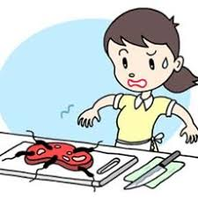
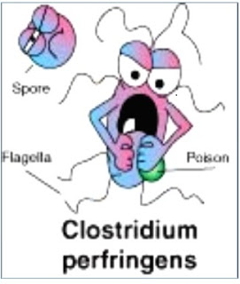
Clostridium perfringens
General information
  of the Clostridiaceae family, is non-motile, anaerobic, (few strains are aerotolerant), spore forming bacteria (subterminal spores) that are encapsulated in tissue smears . Vegetative cells are rod shaped, pleomorphic, and occur in pairs or short chains . It is catalase and superoxide dismutase negative, and has 5 toxigenic types (A-E), of which A and C strains are pathogenic for humans. It produces many different toxins .Colonies with double zone of hemolysis are produced when cultured at 37ºC on blood agar overnight

Slide 61
Clostridium perfringens
Where can it be found?
  Contaminated meats contained in stews, soups and gravies are usually responsible for outbreaks in developed countries and causes about 250,000 cases of food borne illness every year in USA
  C. perfringens is one of the most common causes of food poisoning in United States and Canada
Reservoir
  Soil, water, air, feces of healthy and infected individuals, dust, vegetation, gastrointestinal tract of humans and animals, and variety of dehydrated and processed foods

Slide 62
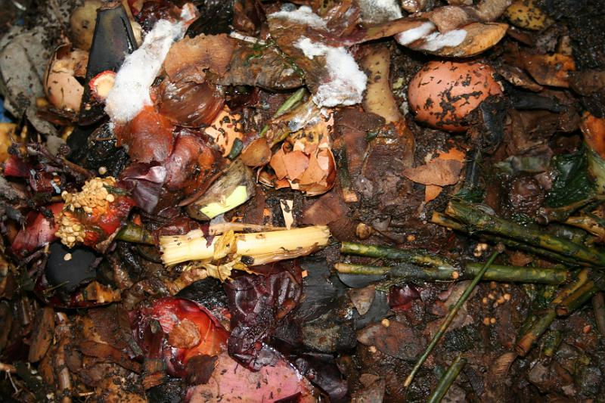
Clostridium perfringens
outside the host
  Spores can survive in soil, crevices, food, decaying vegetation, marine sediments, internal cavities and in the anaerobic conditions inside the meat rolls, animal carcasses, feces, dehydrated and cooked food
  Spores are highly resistant to both heat, and gamma-irradiation. Enterotoxin is heat labile and can be inactivated by heat treatment at 60ºC for 5 minutes.Vegetative cells can be rapidly killed by dry heat at 160-170°C for 1-2 hours or moist heat at 121°C for 15 min- 30 min

Slide 63
Clostridium perfringens
Mode of transmission
  Food Poisoning: Food-borne illness acquired by ingestion of large number of C. perfringens vegetative cells present in the food. Food sources are usually cooked meat, vegetables, fish or poultry dishes which have been stored at ambient temperatures for a long time after cooking.
  Enteritis Necroticans: Ingestion of contaminated pork meat
  Gas Gangrene/ Anaerobic Cellulitis: Infection can occur through contamination of wounds (fractures, bullet wounds) with dirt or any foreign material contaminated with C. perfringens

Slide 64
Clostridium perfringens
Symptoms
  Main symptoms of the disease are nausea, abdominal pain, and diarrhea. The disease is usually mild and self-limiting in healthy individuals, with symptoms resolving within 24 hours
  infectious dose is unknown
  Food poisoning can be caused by C. perfringens enterotoxin (CPE) produced by C. perfringens spores in the small intestine

Slide 65
Clostridium perfringens
Resources
  Pathogen Regulation Directorate, ‘Public Health Agency of Canada- Clostridium perfringens’ December 2011 https://www.canada.ca/en/public-health/services/laboratory-biosafety-biosecurity/pathogen-safety-data-sheets-risk-assessment/clostridium-perfringens.html

